Slide 1
Duquesne Center For Legal Information
Bridge the Gap Between Theory
&
Practice
Part I: Plan Your Research Plan
With Dana Neacşu
&
Katie Lynch
May 17, 2023

Slide 2
Agenda
Start with a a Research Plan
Statutory Research
Legislative History Research
Regulatory Research
Case law Research

Slide 3
Building a Plan: For Whom & Why Thinking about how to use Proximity Connectors? On Lexis On Westlaw

Slide 4
Start with a Research Plan
Statutory Research

Slide 5
Start with a Research Plan --Statutory Research –
Let’s say that you work at the Duquesne Popcorn Factory and need to find whether popcorn promotion and research is protected under federal consumer law.
Plan:
Find a relevant secondary source
Locate the citation to the controlling statute
Read the relevant explanation
Click on the statute
Find relevant case law from the annotations
Use a relevant research aid, e.g., https://trainingtools.thomsonreuters.com/alr/statutes/advanced
Finding the statute by name from the Popular Name Tables/ Index/Full text.

Slide 6
Start with a Research Plan
Start with a Research Plan
Legislative History Research (If using Google, use Google advance)

Slide 7
Start with a Research Plan -- Legislative History Research –
Let’s say that you are working on a case for a client and there is no authoritative case law in your jurisdiction; or you are performing legislative advocacy research.
Plan:
Understanding the legislative process: Introduced; Debated; Enacted; Amended
Finding the statute (Enacted? Amended?)
Selecting the appropriate public law from the statute’s history note
Identifying the Bill’s number or title and running a search to locate it
Reviewing legislative documents

Slide 8
Start with a Research Plan -- Legislative History Research
Let’s say that your friend works in Washington, DC as an aid to Representative John Doe. While you were visiting your friend in DC, they received a text message threatening both the congressperson and your friend. You locate 18 USC 351, but does it apply to both the congressperson and the aid? What is your plan?
Plan:
Find the statute
Locate any potentially relevant text (what if aid or staffer is not mentioned?)
Then locate and review all legislative documents which might shed light on the legislator’s intent.

Slide 9
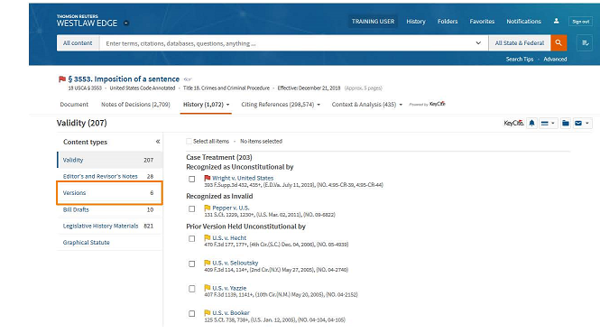
Start with a Research Plan Legislative History Research – Analyzing Historical Statutory Changes
Let’s say that you are working on a criminal case and 18 USC 3553 is relevant to your research. The penalty was changed and you need to see what the imposition of a sentence looked like before its 2011 amendment.
Research Plan:
Start with the citation of the statutory codification: 18 USC 3553 (why the codification?)
What is the major impediment of using this citation? (when did it go into effect?)
How do you find earlier versions?

Slide 10
Start with a Research Plan
Regulatory Research

Slide 11
Start with a Research Plan – Regulatory Research
Let’s say that you see a white-tailed deer which visits the Duquesne campus and before you decide to feed the deer you want to know if you are breaking any PA state or federal regulations. What about the relevant rules if you were on Touro’s campus (in NY?)
Generic Research Plan:
Find a relevant secondary source
Finding the enabling statute
Find the regulatory provision
Specific Regulatory Research Plan:
Search the relevant regulatory compilation (federal or state)
Feed! /s “white-tailed deer”

Slide 12
Start with a Research Plan
Planning for Case law Research

Slide 13
Making a Research Plan Planning for Case law Research –
Let’s say that you work at the Duquesne Law Firm and you have noticed that many clients use emojis when they text or email. You come up with a brilliant idea and you wonder whether you could copyright the use of emojis to sign a contract.
Plan:
Find a relevant secondary source
Treatise
Locate relevant case law
Keycite/Sheperdize the case within the relevant jurisdiction
Use a relevant research aid, e.g., https://trainingtools.thomsonreuters.com/elr/using-cases/getting-started
Find the relevant keynumber 99K314
Locate relevant cases
Update your results

Slide 14
Suggestions & Questions? DCLI@duq.edu

