Slide 1
Duquesne Center For Legal Information
Bridge the Gap Between Theory
&
Practice
Part II: Implement Your Research Plan
With Dana Neacşu
&
Katie Lynch
May 17, 2023

Slide 2
Agenda
Implement Your Research Plan
Start with Secondary Sources
Locate & Access Relevant Secondary Sources
When to Use Treatises vs. Practitioners Resources
Using Treatises & Law Review Articles

Slide 3
Agenda
Start with Secondary Sources

Slide 4
Finding Relevant Secondary Sources on Lexis/Westlaw
Westlaw
Step 1
Go Content Types
Step 2
Secondary Sources page
Step 3
By Type
Lexis
Step 1
Secondary Materials
Step 1
Treatises & Guides…
Step 3
Content Type
Step 3
Practice Area

Slide 5
Agenda
Locating Relevant Secondary Sources

Slide 6
Locating Relevant Secondary Sources on Westlaw/Lexis
Westlaw
Step 4
To locate a treatise – run a search for the area of law (torts/copyright/federal practice, etc.)
Step 5
Once the relevant source located, run your query using the legal issues & concepts identified while planning your search
Lexis
Step 3
Click on the area of law and scroll through the list of sources to locate a treatise on the relevant topic (torts/copyright/federal practice, etc.)
Step 5
Once the relevant source located, run your query using the legal issues & concepts identified while planning your search

Slide 7
Agenda
Treatises: When to Use Them & Why?

Slide 8
Treatises: When to Use Them & Why?
What is a Treatise?
A treatise focuses on a single area of law and is written by experts in that area. Treatises range from broad, multi-volume sets to narrowly focused one-volume titles.
Why Use a Treatise?
Practitioners rely heavily on treatises for the detailed coverage and practical tips they contain. The content varies tremendously, but you can usually find thorough explanations of the law at issue along with citations to relevant cases, statutes, regulations, and other secondary sources. Some treatises also contain the full text of these materials in appendices.
Finding Treatises
You can locate relevant treatises by legal subject area using a Treatise Finders guide or by keyword searching in the DCLI- Law Library's catalog.

Slide 9
Treatises: When to Use Them & Why?
Let’s say that you work at the Duquesne Popcorn Factory and need to find whether your popcorn promotion logo is protected under federal law.
Plan:
Find a relevant secondary source
What area of law?
If in doubt how would you determine it?
What treatise?
Depends on the platform you use: Lexis/Westlaw

Slide 10
More ways to locate & access e-Treatises
Westlaw
On the homepage search bar type the area of law you are looking into
Westlaw will pull up a list of suggested titles
Lexis
On the homepage search bar type the area of law you are looking into
Lexis will pull up a list of suggested titles

Slide 11
Treatises vs. Practitioners’ Resources
Let’s try a more practical question:
Are federally guaranteed student loans dischargeable in bankruptcy?
Plan:
On what platform?
NB: Lexis and Westlaw have different practitioner’s sources (materials written by practitioners for practitioners, ergo: concise and up-to-date)
Implement Your Research Plan
Locate a Westlaw and a Lexis treatise;
Run your query;
What did you find? Are federally guaranteed student loans dischargeable in bankruptcy?
Thinking about how to use Proximity Connectors? On Lexis On Westlaw

Slide 12
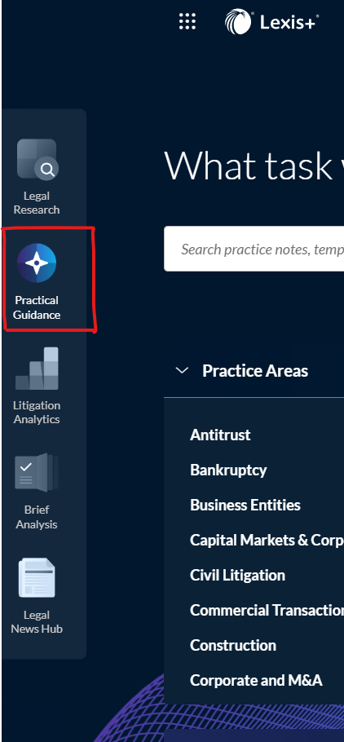
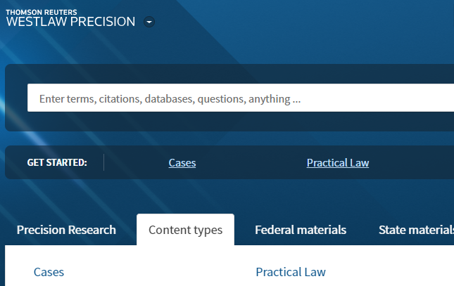
Treatises vs. Practitioners’ Resources
Are federally guaranteed student loans dischargeable in bankruptcy?
Implement Your Research Plan
Choose Lexis’ Practical Guidance:
Run your query;
What did you find?
Let’s choose Westlaw’s Practical Law
Run your query;
What did you find? Are federally guaranteed student loans dischargeable in bankruptcy?

Slide 13
Agenda
Law Review Articles: When to Use Them and Why

Slide 14
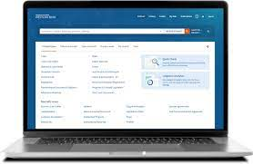
Law Review Articles: When to Use Them & Why

Slide 15
Law Review Articles: When to Use Them & Why
Hypothetical: What are the ethical obligations of lawyers using ChatGPT?
Plan:
Choose a platform
Either locate the law reviews and journals library before you type your query, or use the available filters afterwards
Using Law Reviews and Journals to Implement Your Research Plan
Run your query (using proximity connectors)
What did you find?
Thinking about how to use Proximity Connectors? On Lexis On Westlaw

Slide 16
Suggestions & Questions? DCLI@duq.edu

